Slide 1
Claim Justification using Subject Predicate Distance
Enrollment No: P23DS004
NIT Surat, India

Slide 2
Contents
Introduction
Proposed Work
Methodology
Working of Algorithm
Results
Conclusion
Limitations and Future Work

Slide 3


1.1. Introduction
Claim
Justification

Slide 4
1.2. Motivation
Handle inter-dependent sentences.
Processing time of entire sentence.

Slide 5
2. Proposed Work
Identify Subject Predicate from Claim and Justifications.
Measure Subject Predicate Distance (SPD) using pretrained word embedding model.

Slide 6
3. Methodology
Input: Claim (1 sentence) and Justifications (5<= sentences)
Select top 5 justification close to claim using roberta-large-mnli (NLI Model)
Apply SPD vectorization algorithm on claim and 5 justification sentences
Output: 100 dimensions vector representation of claim-justification

Slide 7
3. Methodology (Research Work)
Input: Single Sentence (s)
Apply POS Tagging on sentence (s) using genism NLTK
Get subject using noun/pronoun and predicate using adjective/verb
Return difference of their word embeddings using Wikipedia pretrained model
Output: 100 dimensions vector

Slide 8
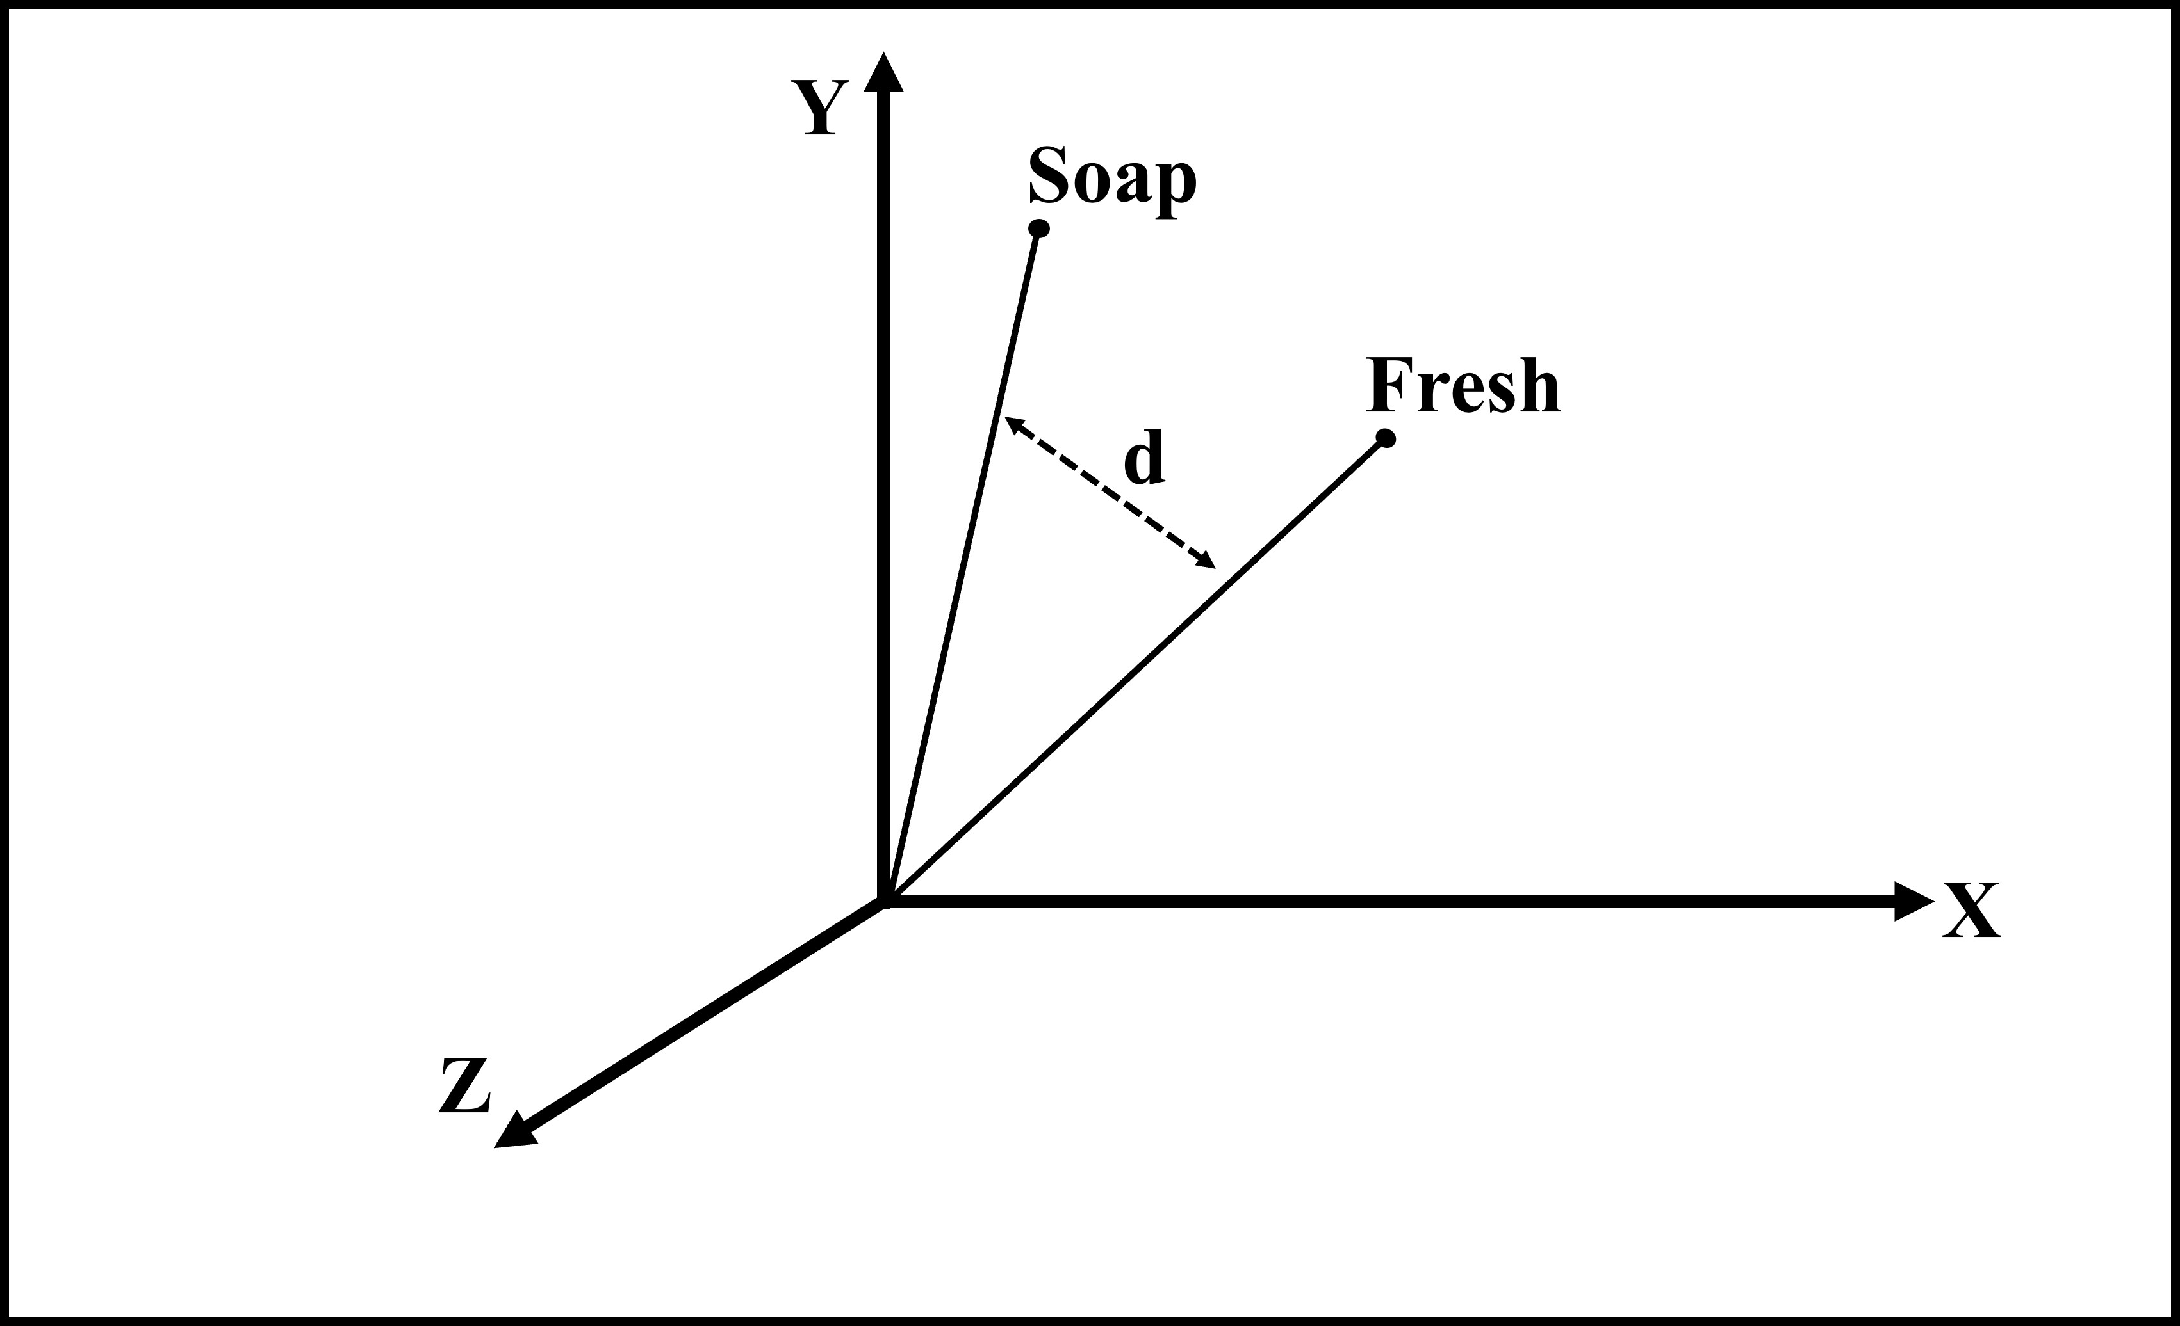
4. Working of Algorithm
Claim: Soap of xyz company keeps you fresh for entire day.
Justifications:
xyz soap has menthol in it.
abc celebrity uses xyz soap.
Subject Predicate Distance (d) of claim

Slide 9
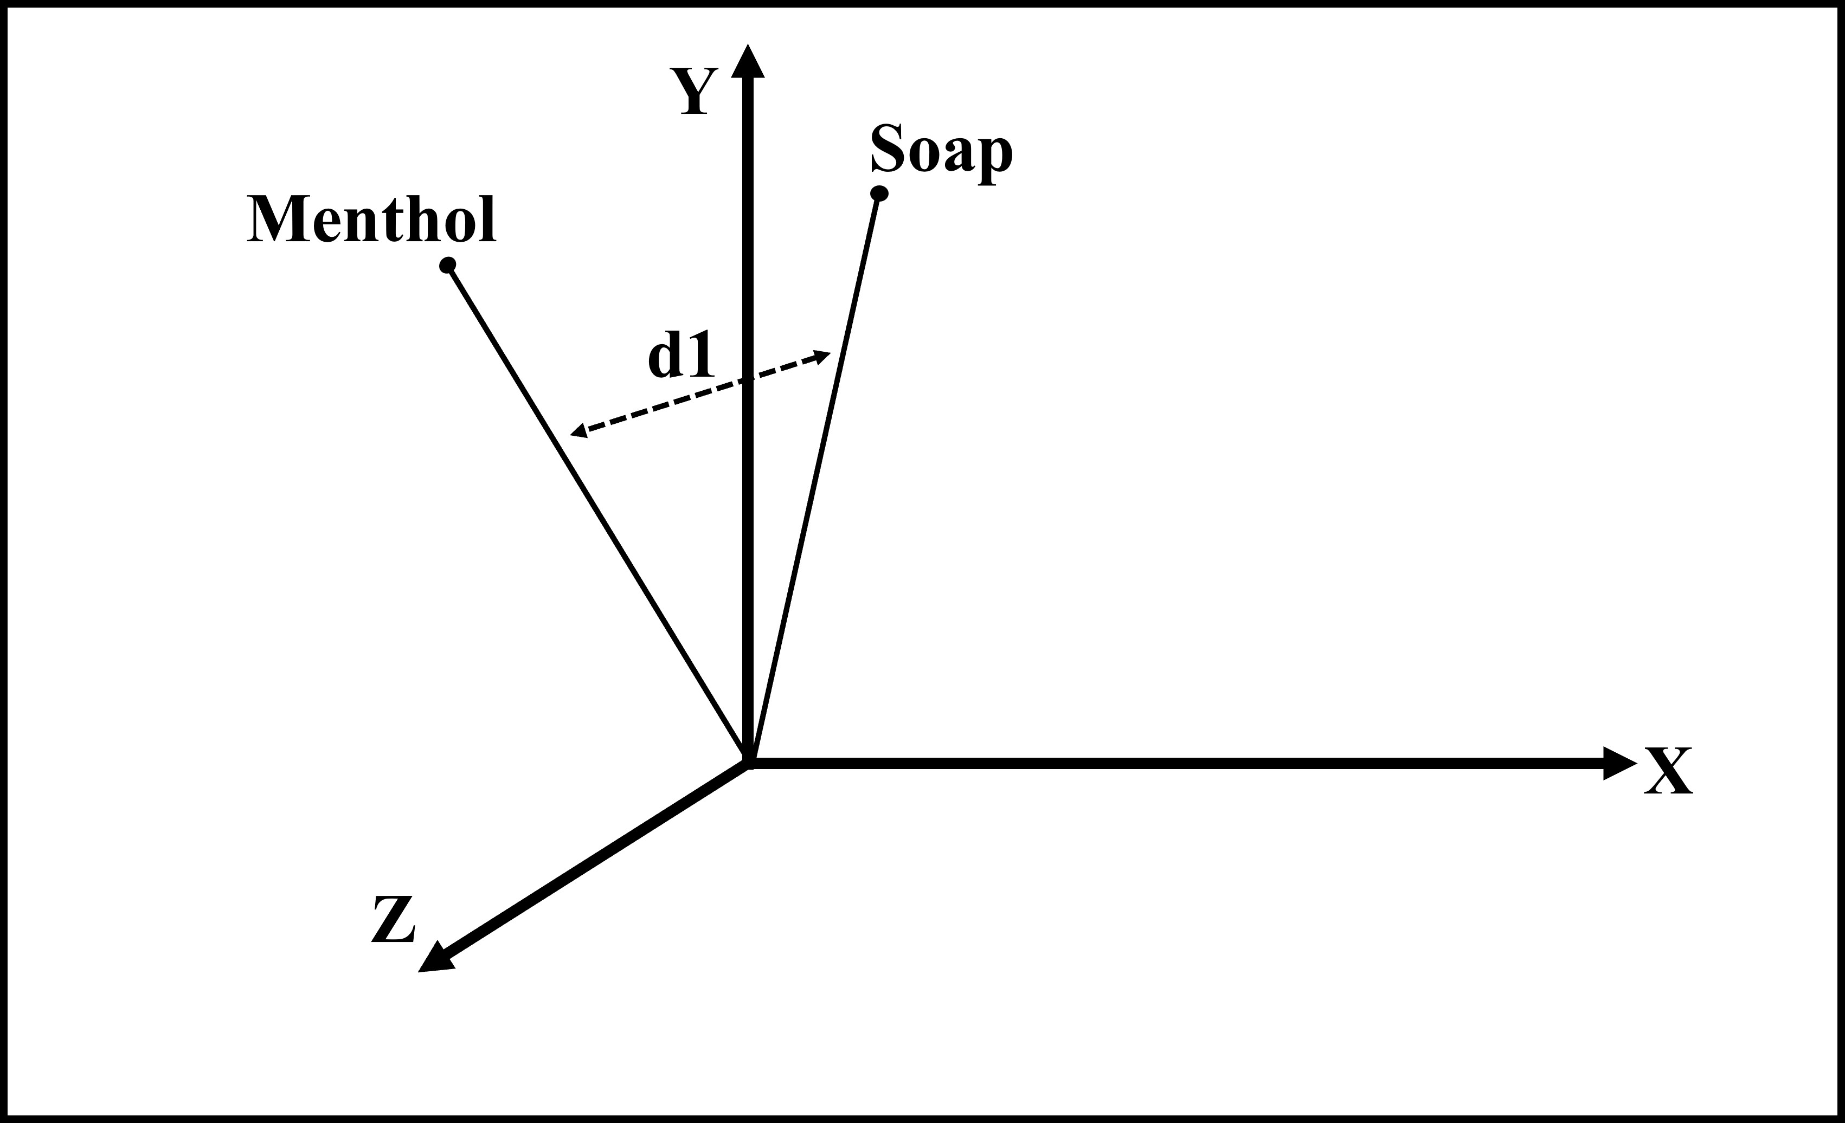
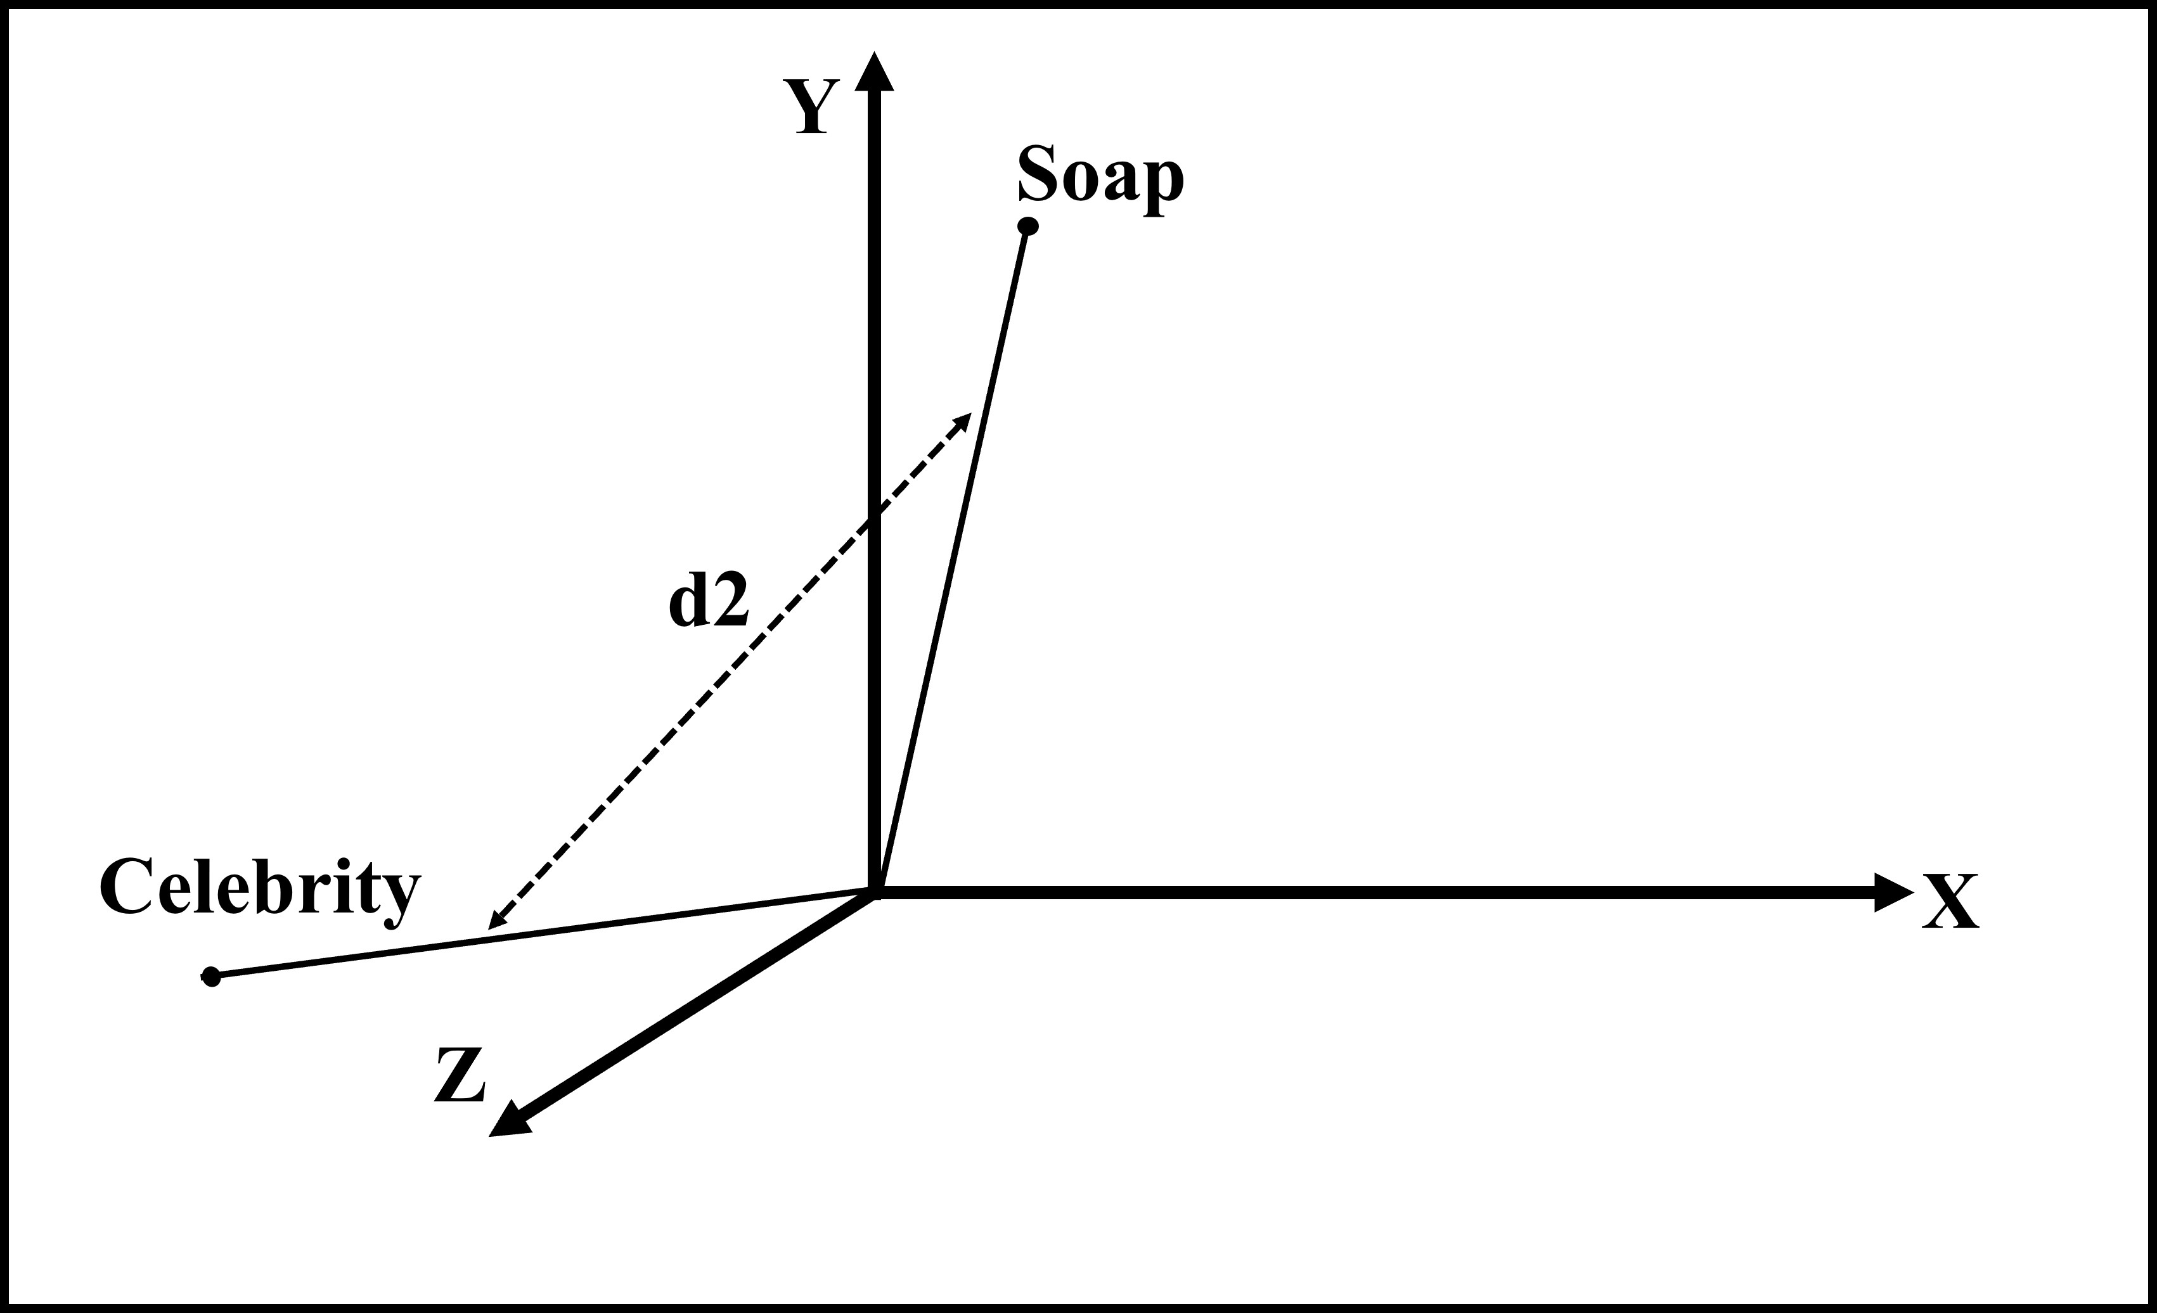
4. Working of Algorithm
Claim: Soap of xyz company keeps you fresh for entire day.
Justifications:
xyz soap has menthol in it.
abc celebrity uses xyz soap.
Subject Predicate Distance (d1) of justification 1
Subject Predicate Distance (d2) of justification 2

Slide 10
5. Results
 | s-BERT vectors | SPD vectors (proposed work)
Classifier 1 | 65.51% | 66.28%
Classifier 2 | 73.75% | 73.76%
Classifier 3 | 77.00% | 77.01%
Classifier 4 | 51.32% | 53.27%
Classifier 5 | 62.32% | 62.12%
Time Taken | 150 minutes | 100 minutes

Slide 11
6. Conclusion
Efficient way to capture claim-justification embeddings.
33% faster and 50% less computation.
Real-life application: fake speech, inconsistent resume, misleading advertisement.

Slide 12
7. Limitations and Future Work
Better way to identify subject and predicate.
More operations to measure subject predicate distance.
Accurate word embedding model.

Slide 13
Thank You

